Slide 1
Know your Data:
Measuring Data Similarity and Dissimilarity
By
Dr. Prashant Singh Rana
Computer Science and Engineering Department,
Thapar Institute of Engineering and Technology,
Patiala, Punjab – 147004
www.psrana.com | psrana@gmail.com
1
Notes:
1

Slide 2
Similarity and Dissimilarity
Similarity
Numerical measure of how two data objects are alike.
Value falls in the range [0,1]
Value is higher when objects are more alike
Dissimilarity (e.g., distance)
Numerical measure of how two data objects are different.
Value falls in the range [0,n]
Minimum dissimilarity is often 0
Upper limit varies to n.
Proximity refers to a similarity or dissimilarity

Slide 3
Data Matrix and Dissimilarity Matrix
Data matrix
n data points with p dimensions
Dissimilarity matrix
n data points, but registers only the distance
A triangular matrix

Slide 4
Proximity Measure for Nominal Attributes
Can take 2 or more states, e.g., red, yellow, blue, green (generalization of a binary attribute)
Method 1: Simple matching
m: # of matches, p: total # of variables
Method 2: Use a large number of binary attributes
creating a new binary attribute for each of the M nominal states

Slide 5
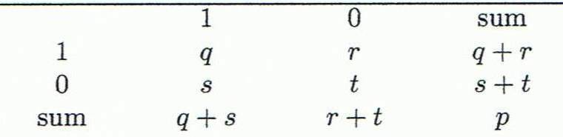
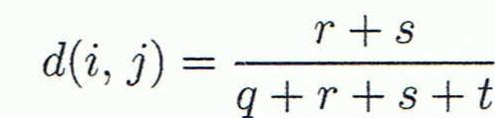
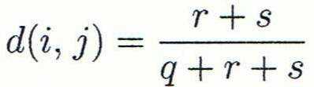
Proximity Measure for Binary Attributes
A contingency table for binary data
Distance measure for symmetric binary variables:
Distance measure for asymmetric binary variables:
Object j
Object i

Slide 6

Proximity Measure for Binary Attributes
Jaccard coefficient (similarity measure for asymmetric binary variables):
Note: Jaccard coefficient is the same as “coherence”:

Slide 7
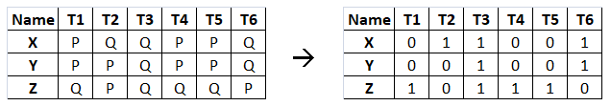

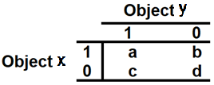


Example: Proximity Measure for Binary Attributes
Given Data
Steps:
3. Find:
Symmetric distance
Asymmetric distance
Coherence (Jaccard coefficient)
1. Convert data to binary
P→ 0 Q→ 1
2. Contingency table for binary data
Count the number of a, b, c, d
a ← (1,1) b ← (1,0)
c ← (0,1) d ← (0,0)

Slide 8
Example: Proximity Measure for Binary Attributes
Distance:
D(x,y): a=2, b=1, c=0, d=3
D(x,z): a=1, b=2, c=3, d=0
D(y,z): a=1, b=1, c=2, d=1
Distance | Symmetric Measure | Asymmetric Measure | Coherence
D(x,y) | (1+0)/(2+1+0+4) = 0.14 | (1+0)/(2+1+0) = 0.33 | 2/(2+1+0) =0.67
D(x,z)
D(y,z)

Slide 9
Dissimilarity between Binary Variables
Gender is a symmetric attribute
The remaining attributes are asymmetric binary
Let the values Y and P be 1, and the value N 0

Slide 10
Dissimilarity between Binary Variables

Slide 11
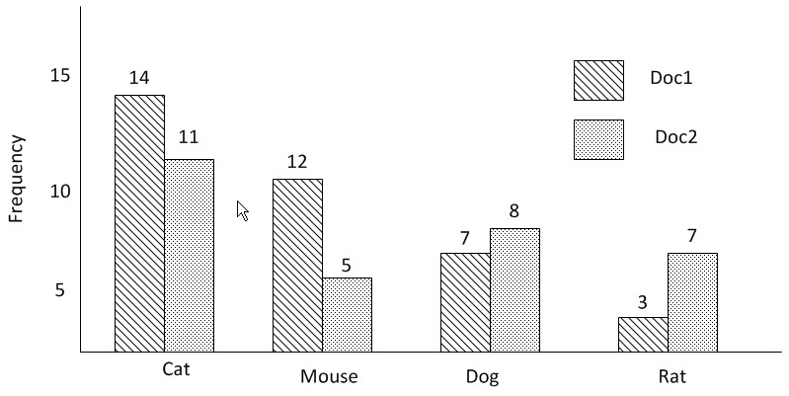
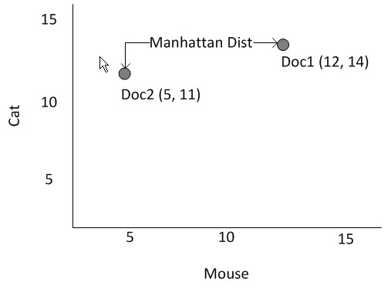
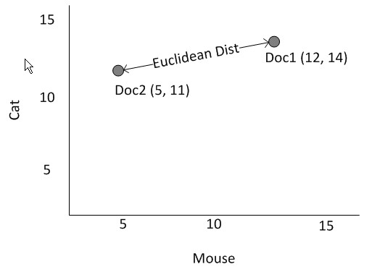
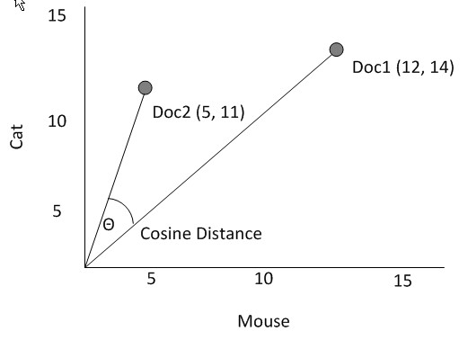
Data Matrix and Dissimilarity Matrix
Euclidean, Manhattan and Cosine Distance Measures

Slide 12
Distance on Numeric Data: Minkowski Distance
Minkowski distance: A popular distance measure
where i = (x_{i1}, x_{i2}, …, x_{ip}) and j = (x_{j1}, x_{j2}, …, x_{jp}) are two p-dimensional data objects, and h is the order (the distance so defined is also called L-h norm)
Properties
d(i, j) > 0 if i ≠ j, and d(i, i) = 0 (Positive definiteness)
d(i, j) = d(j, i) (Symmetry)
d(i, j) ≤ d(i, k) + d(k, j) (Triangle Inequality)
A distance that satisfies these properties is a metric

Slide 13
Special Cases of Minkowski Distance
h = 1: Manhattan (city block, L₁ norm) distance
E.g., the Hamming distance: the number of bits that are different between two binary vectors
h = 2: (L₂ norm) Euclidean distance
h → ∞. “supremum” (L_{max} norm, L∞ norm) distance.
This is the maximum difference between any component (attribute) of the vectors

Slide 14
Example: Minkowski Distance
Dissimilarity Matrices
Manhattan (L₁)
Euclidean (L₂)
Supremum

Slide 15
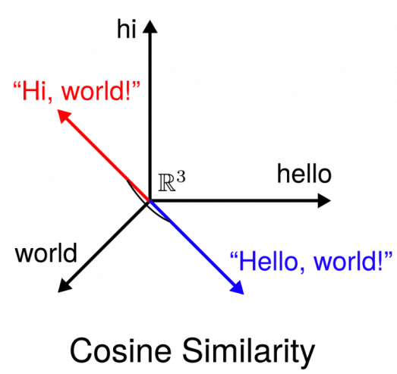
Cosine Similarity
Cosine similarity is a metric used to measure how similar the documents are irrespective of their size.
Mathematically, it measures the cosine of the angle between two vectors projected in a multi-dimensional space.

Slide 16
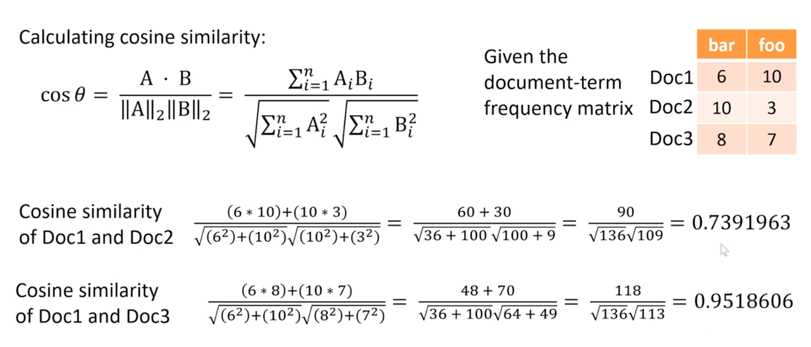
Example 1: Cosine Similarity

Slide 17
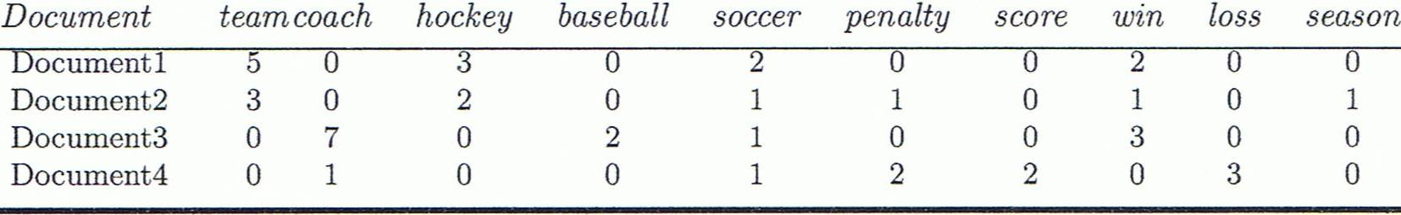
Example 2: Cosine Similarity
cos(d₁, d₂) = (d₁ • d₂) /||d₁|| ||d₂|| ,
where • indicates vector dot product, ||d|: the length of vector d
Ex: Find the similarity between documents 1 and 2.
d₁ = (5, 0, 3, 0, 2, 0, 0, 2, 0, 0)
d₂ = (3, 0, 2, 0, 1, 1, 0, 1, 0, 1)
d₁•d₂ = 5*3+0*0+3*2+0*0+2*1+0*1+0*1+2*1+0*0+0*1 = 25
||d₁||= (5*5+0*0+3*3+0*0+2*2+0*0+0*0+2*2+0*0+0*0)^{0.5}
=(42)^{0.5} = 6.481
||d₂||= (3*3+0*0+2*2+0*0+1*1+1*1+0*0+1*1+0*0+1*1)^{0.5}
=(17)^{0.5} = 4.12
cos(d₁, d₂ ) = 25 / (6.481 * 4.12) = 0.94

Slide 18
Thanks
Contact for any query: www.psrana.com | psrana@gmail.com

